Slide 1

A Web Framework to Predict Fake News Using ML
Group No: 13
Jaagrut Shah 19204002
Jigar Desai 19204003
Yash Jain 19204013
Guided by:
Prof. Apeksha Mohite
Prof. Geetanjali Kalme
Notes:
1

Slide 2
Contents
Introduction
Literature Review
Objectives
Scope
Technology Stack
Block Diagram to propose project idea.
Flow Diagram
References
Notes:
2

Slide 3
1. Introduction
Fake News Prediction using ML.
Problem Identified :
The easy access and exponential growth of the information available on social media networks has made it intricate to distinguish between false and true information.
The easy dissemination of information by way of sharing has added to exponential growth of its falsification.
Solution Proposed :
With the help of ML Algorithms, and the data sets we would try to eliminate the fake news which is being spread and trying to alter the emotions of people reading news.
Notes:
3

Slide 4
2. Literature Review
Sr. No. | Authors | Paper Tittle | Methodologies | Findings
1 | Ahmed et al | Detection of online fake news using n-gram analysis and machine learning technique | ML models like KNN, SVM, ST, etc. | ML models including K-nearest neighbor (KNN), support vector machine (SVM), logistic regression (LR), linear support vector machine (LSVM), decision tree (DT), and stochastic gradient descent (SGD), achieving the highest accuracy (92%) with SVM and logistic regression.
2 | Shu et al | Fake news detection on social media | Calculating n grams using Textual features like TFID vectorizer and ML algorithm | Achieved better accuracies with different models by combining textual features with auxiliary information such as user social engagements on social media

Slide 5
3. Objectives
To achieve accuracy in predicting true and reliable news, show the news relevance and analysis.
To work in this project proposes a stacked model which fine-tunes the informational insight gained from the data at each step and then tries to make a prediction.
To make evident success in the prediction of fake news and posts using a various Machine learning approach.
To eliminate news that is misleading the users reading them being spread through social media.
To be able to provide more and great accuracy of the News displayed.
Notes:
5

Slide 6
4. Scope
The fake news challenge is perilous and is spreading rapidly like a wildfire as it becomes easier for information to reach the mass in various flavors.
Fake news can have a huge impact in politics and thereafter on the people like a domino effect. With the help of Machine Learning & Artificial Intelligence, we can control and limit the spread of such misinformation more quickly and efficiently as compared to manual efforts.
There are various Up’s and Down’s on the market or in people’s lives after they read the news that was Falsely claimed to be True. This project will assure them, that the news is True or False, this approach will Solve many problems like riots.
Notes:
6

Slide 7
5. Technology Stack
Software Requirements:
Python libraries
ReactJS
Bootstrap
Framework: Flask
PostgreSQL and for monitoring: PG Admin
Machine-Learning Classification models
OS Requirements: Windows XP or above
JavaScript supported browsers
Hardware Requirements:
Minimum 2GB Ram
Pentium / Intel i3 Processors or above
Notes:
7

Slide 8
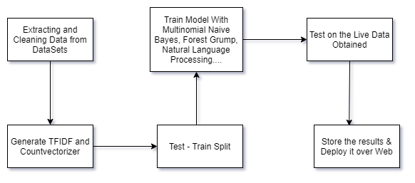
6. Block Diagram to propose Project Idea
Notes:
8

Slide 9
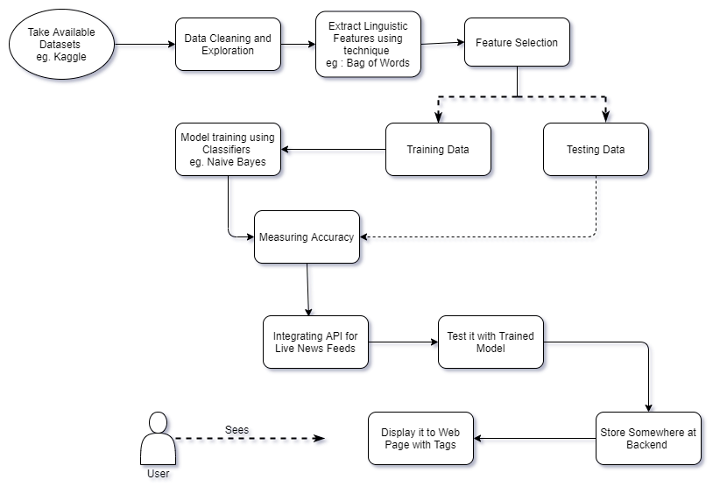
7. Flow Diagram
Notes:
9

Slide 10
8. References
S. A. García, G. G. García, M. S. Prieto, A. J. M. Guerrero, and C. R. Jiménez, “The impact of term fake news on the scientific community scientific performance and mapping in web of science,” Social Sciences, vol. 9, no. 5, 2020.
Ammara Habib, Muhammad Zubair Asghar, Adil Khan, Anam Habib, Aurangzeb Khan, “False information detection in online content and its role in decision making: a systematic literature review”, Springer-Verlag GmbH Austria, part of Springer Nature 2019.
D. M. J. Lazer, M. A. Baum, Y. Benkler et al., “The science of fake news,” Science, vol. 359, no. 6380, pp. 1094–1096, 2018.
Mykhailo Granik, Volodymyr Mesyura, “Fake News Detection using Naïve Bayes Classifier”, 2017 IEEE First Ukraine Conference on Electrical and Computer Engineering.
Shlok Gilda,” Evaluating Machine Learning Algorithms for Fake News Detection”, 2017 IEEE 15th Student Conference on Research and Development.
Notes:
10

Slide 11
Thank You...!!
Notes:
11

